Slide 1

Chapter-4
Approches to Testing -II

Slide 2

Dynamic Testing
Describes Technique for testing of s/w by executing the test objects on a computer.

Slide 3
Dynamic Testing - A Type of Verification
What Does Dynamic Testing Do ?
Involves Execution of a System or Component
Selection of a Group of Test Cases Consisting of Test Data
Finding out Output Test Results out of Input Test Cases
Systematic approach is determination of the test cases

Slide 4
Test Bed
Test Driver
Test
Case 1
Test
Case 2
…….
Test
Case n
.
Stub 1
PoC
Stub 2
Test Output
Comparison
& protocol
Test Object
PoO
….
Stub k
Run time environment,
Analysis tools, monitors
Test Stubs

Slide 5
Test Bed
Testing- execution of Test object on a computer
In Component & Integration testing, the test object can not be run alone, but it must be embedded into a test bed to obtain executable program

Slide 6
Test Design Technique
Test bed necessary
Systematic approach at determination of the test cases
Incremental approach
Conditions, preconditions, & goals
Test case specification
Determine expected result & behavior
Test case execution

Slide 7
Dynamic Testing
Divided into 2 categories :
  Black Box Testing
  White Box Testing

Slide 8
Test input data
Black box approach
White box approach
Test input data
Test input data
Test o/p
Test input data
Test object
Test object
o/p
Test object
Test object
M1(a,b,c)
o/p

Slide 9
Black box versus white box?
Black box appropriate
at all levels but
dominates higher
levels of testing
White box used
predominately
at lower levels
to compliment
black box
Acceptance
System
Integration
Component

Slide 10

Black Box Testing

Slide 11
Black Box Testing
Inner structure & design of test object is unknown
Test cases are derived from specification
Test design must make a reasonable selection.

Slide 12
What is black box testing?
Black box testing also known as specification-based testing.
- Black box testing refer to test activities using specification-based testing methods and criteria to discover program errors based on program requirements and product specifications.
The major testing focuses:
- specification-based function errors
- specification-based component/system behavior errors
- specification-based performance errors
- user-oriented usage errors
- black box interface errors interface

Slide 13
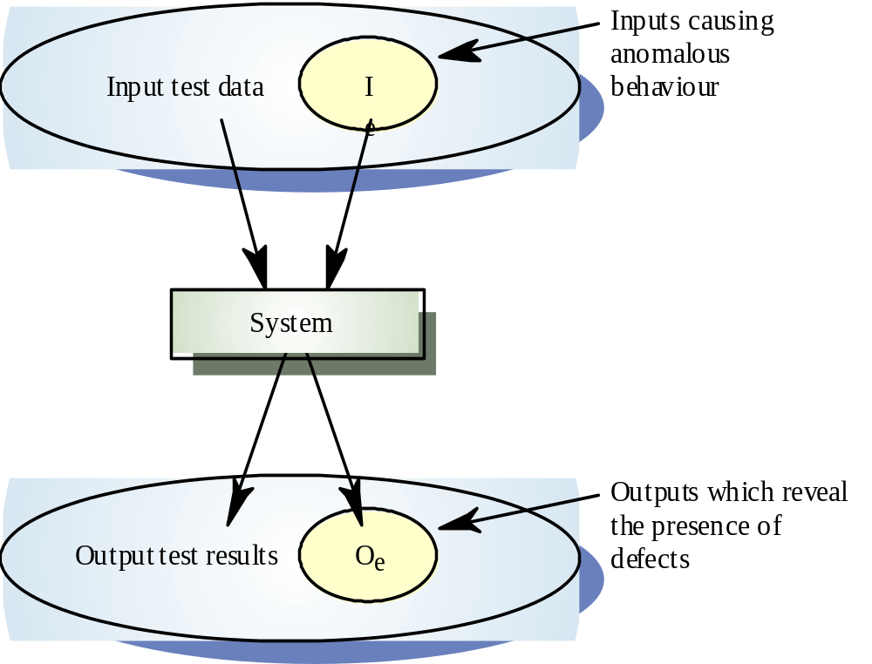
Black Box Testing

Slide 14
Black Box Testing Technique
Using test black box testing the inner structure and design of test object is unknown or not considered.
There are couple of method :
  Equivalence partitioning
  Boundary value analysis
  State transition

Slide 15
Advantages of Black Box Testing
Tester can be non-technical.
- Used to verify contradictions in actual system and the specifications.
- Test cases can be designed as soon as the functional specifications are complete

Slide 16
Disadvantages of Black Box Testing
The test inputs needs to be from large sample space.
It is difficult to identify all possible inputs in limited testing time. So writing test cases is slow and difficult
Chances of having unidentified paths during this testing

Slide 17
Equivalence Class Partioning
Input data and output results often fall into different classes where all members of a class are related
Each of these classes is an equivalence partition where the program behaves in an equivalent way for each class member
Test cases should be chosen from each partition (or class)

Slide 18
Equivalence Class Partioning
Input domain are divided into equivalence classes
Correct equivalence classes & representatives
Equivalence classes with partitioning
Systematic derivation of the test cases
Further partitioning of the equivalence class
Equivalence class for output value
Boundaries of the equivalence class

Slide 19
Equivalence partitioning (EP)
  divide (partition) the inputs, outputs, etc. into areas which are the same (equivalent)
  assumption: if one value works, all will work
  one from each partition better than all from one
invalid
valid
invalid
0
1
100
101

Slide 20
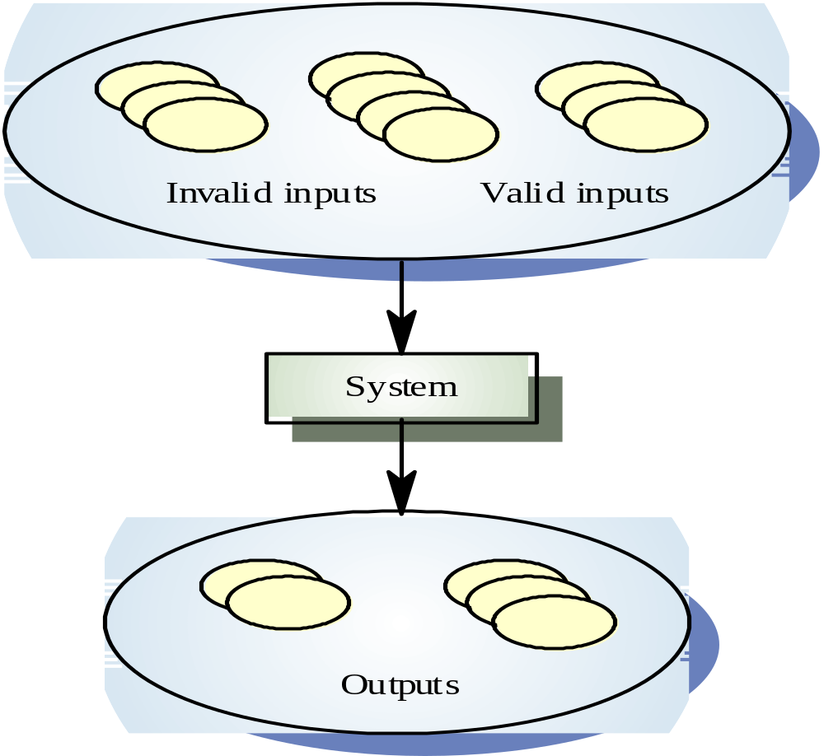

Slide 21
Guidelines for equivalence classes
If an input condition specifies range,
  one valid and two invalid equivalence classes are needed
If a condition requires a specific value,
  then one valid and two invalid equivalence classes are needed
If an input condition specifies a member of a set,
  one valid and one invalid equivalence class are needed
If an input condition is Boolean,
  one valid and one invalid class are needed

Slide 22
Test Cases
Combination of the representatives
Rules of test case determination
Seperate test of the invalid value
Restriction of the no. of test cases
Test invalid value seperately

Slide 23
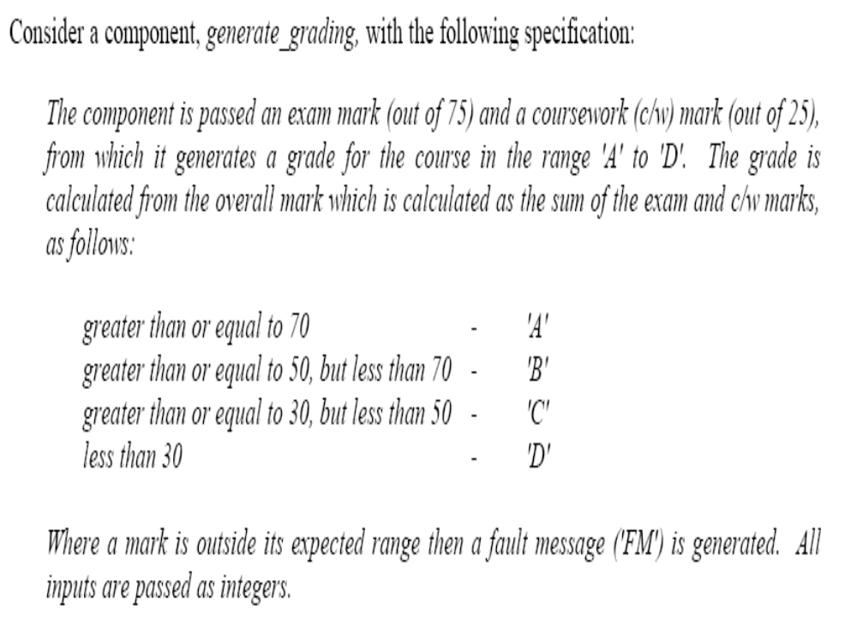
Example 2: Equivalence Partitioning
.

Slide 24
Valid partitions
The valid partitions can be
  0<=exam mark <=75
  0<=coursework <=25

Slide 25
Invalid partitions
The most obvious partitions are
  Exam mark > 75
  Exam mark < 0
  Coursework mark > 25
  Coursework mark <0

Slide 26
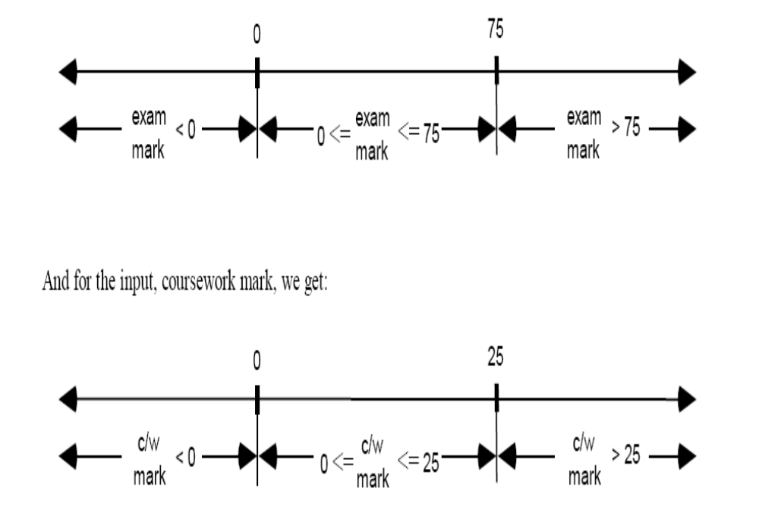
Exam mark and c/w mark

Slide 27
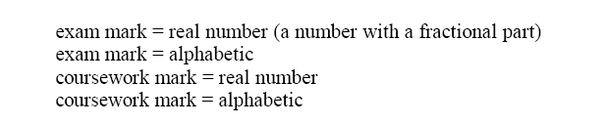
Less obvious invalid input EP
invalid INPUT EP should include

Slide 28
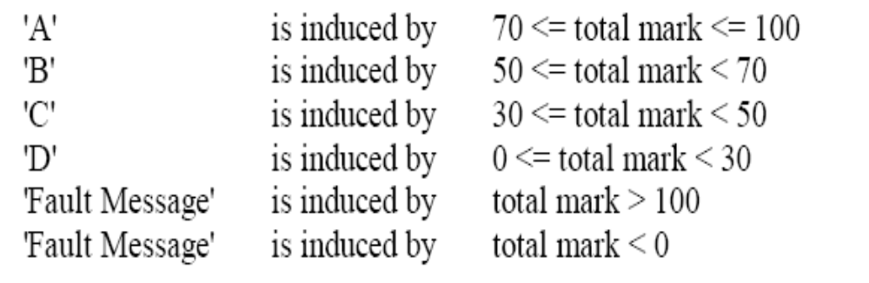
Partitions for the OUTPUTS
EP for valid OUTPUTS should include

Slide 29
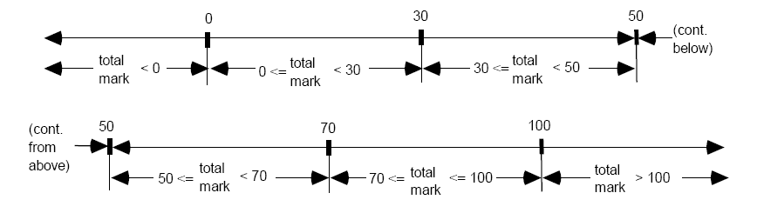
The EP & Boundary values
The EP and boundaries for total mark

Slide 30
Unspecified Outputs
Three unspecified Outputs can be identified (very subjective)
  Output = “E”
  Output = “A+”
  Output = “null”

Slide 31
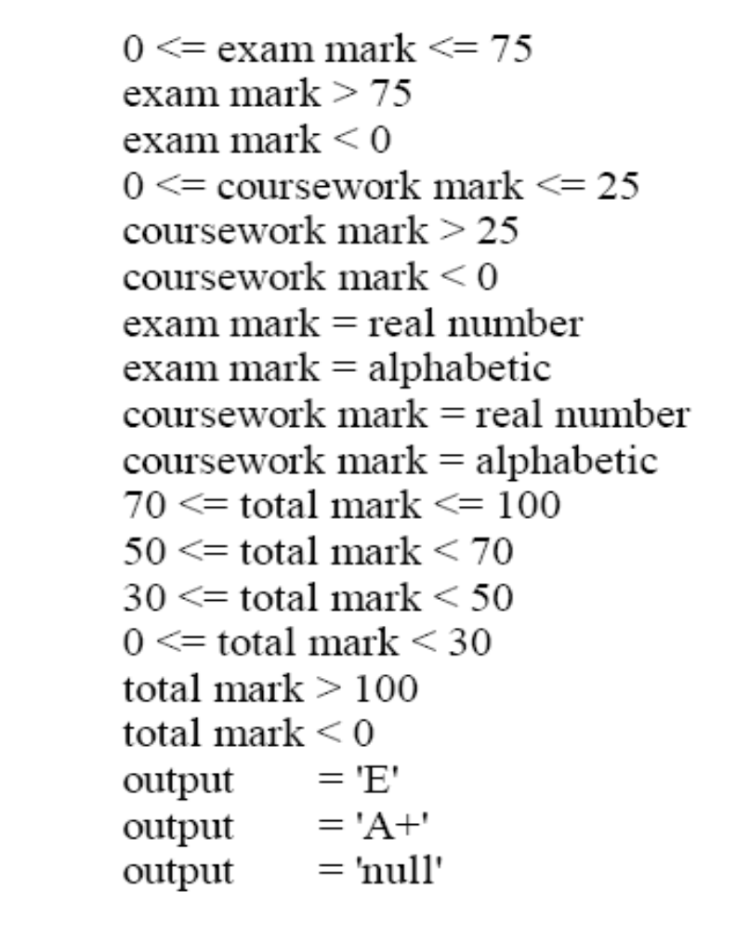
Total PE

Slide 32
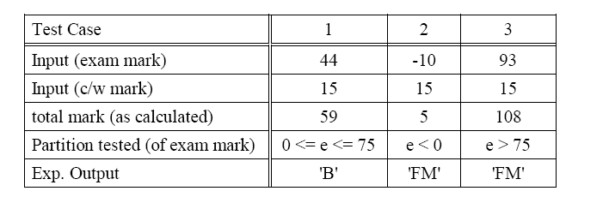
Test Cases corresponding to PE exam mark (INPUT) ( test cases 1, 2,3 )

Slide 33
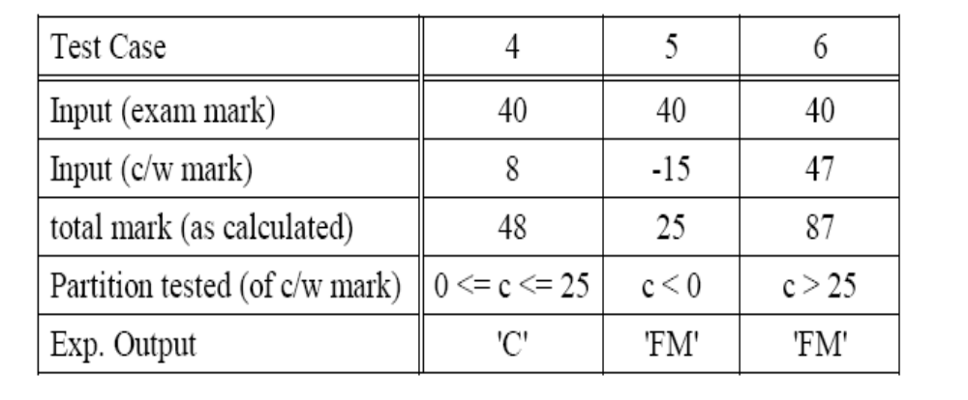
Test Case 4-6 (coursework)

Slide 34
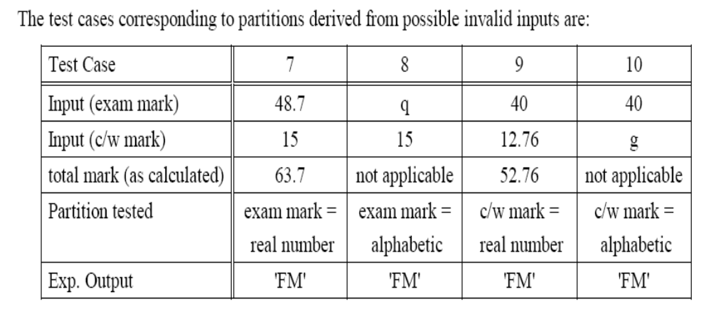
Test case for Invalid inputs (7 to 10)

Slide 35
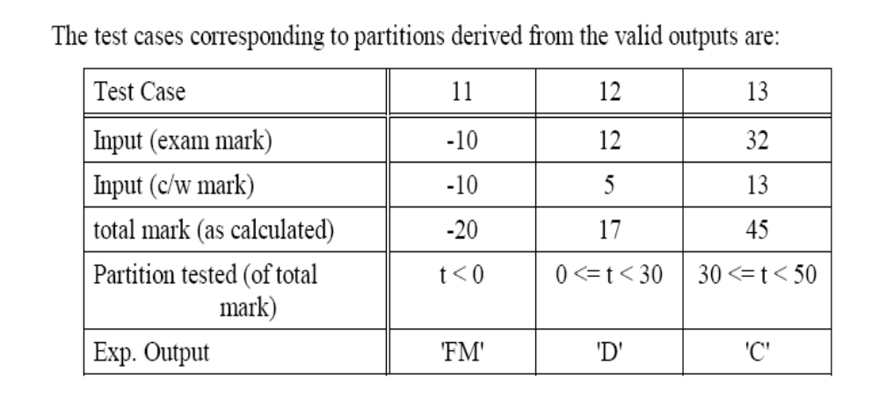
Test cases for invalid outputs:11 to 13 test case

Slide 36
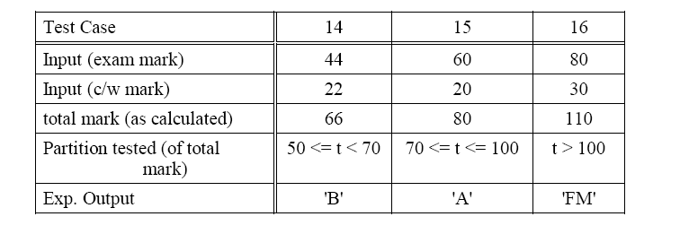
Test cases for invalid outputs:2

Slide 37
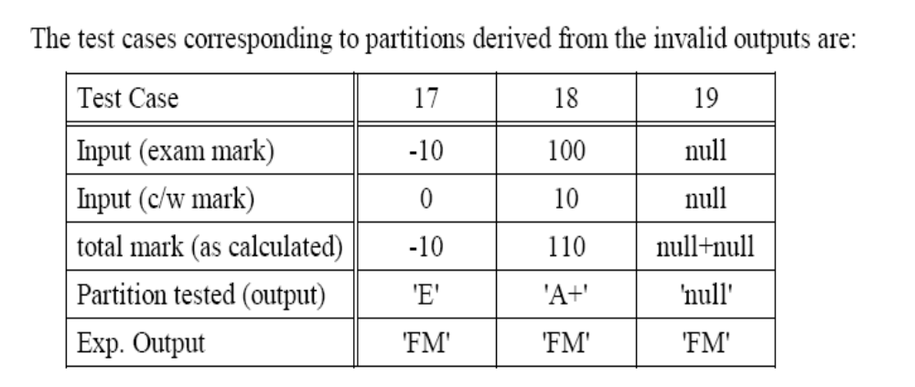
Test cases for invalid outputs:3

Slide 38
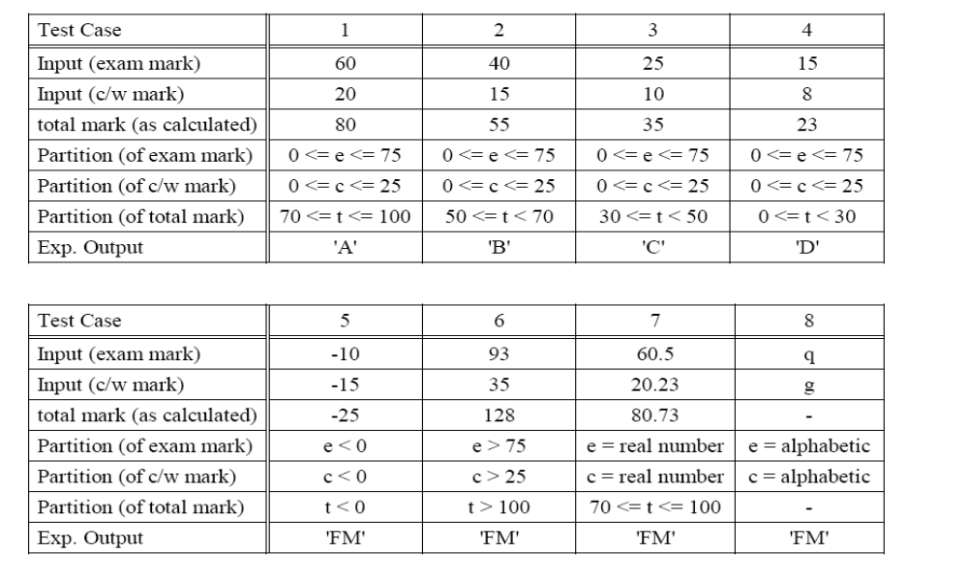
Minimal Test cases:1

Slide 39
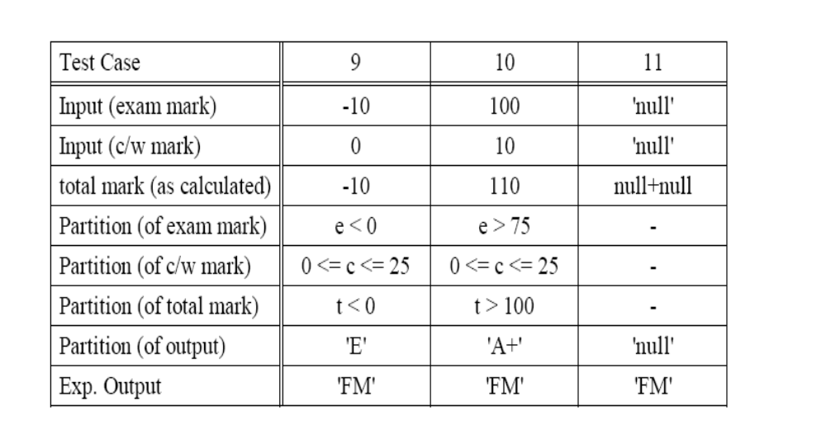
Minimal Test cases:2

Slide 40
Boundary Value Analysis
Complements equivalence partitioning
Focuses is on the boundaries of the input
If input condition specifies a range bounded by a certain values, say, a and b, then test cases should include
  The values for a and b
  The values just above and just below a and b
If an input condition specifies any number of values, test cases should be exercise
  the minimum and maximum numbers,
  the values just above and just below the minimum and maximum values

Slide 41
Many systems have tendency to fail on boundary. So testing boundary values of application is important. Boundary Value Analysis (BVA) is a test Functional Testing technique where the extreme boundary values are chosen. Boundary values include maximum, minimum, just inside/outside boundaries, typical values, and error values.
Extends equivalence partitioning
Test both sides of each boundary
Look at output boundaries for test cases too
Test min, min-1, max, max+1, typical values

Slide 42
Boundary Value Analysis
  faults tend to wait near boundaries
  good place to look for faults
  test values on both sides of boundaries
invalid
valid
invalid
0
1
100
101

Slide 43
Example: Loan application
2-64 chars.
Customer Name
Account number
Loan amount requested
Term of loan
Monthly repayment
Term:
Repayment:
Interest rate:
Total paid back:
6 digits, 1st
non-zero
£500 to £9000
1 to 30 years
Minimum £10

Slide 44
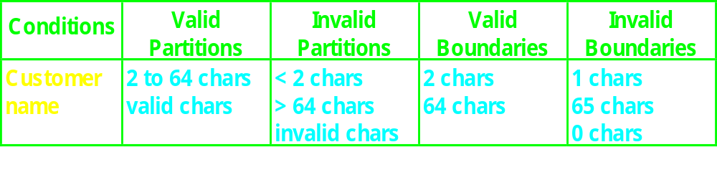
Customer name
Number of characters:
1
2
64
65
invalid
valid
invalid
Valid characters:
A-Z
a-z
Any
other
-’
space

Slide 45
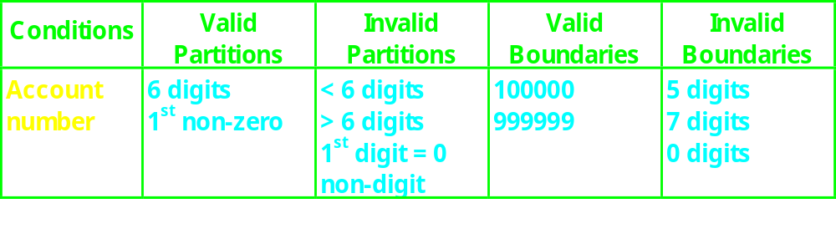
Account number
valid: non-zero
first character:
invalid: zero
number of digits:
5
6
7
invalid
invalid
valid

Slide 46
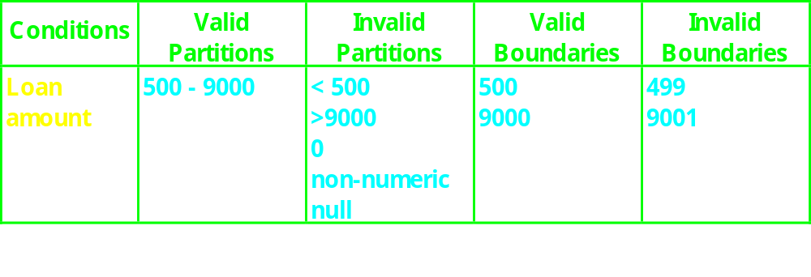
Loan amount
499
500
9000
9001
invalid
valid
invalid

Slide 47
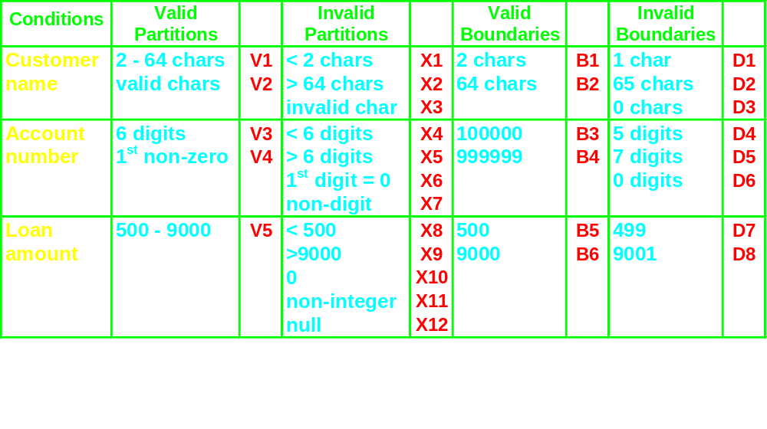
Condition template

Slide 48
Design test cases
Test
Description
Expected Outcome
New Tags
Case
Covered
1
Name: John Smith
Acc no: 123456
Loan: 2500
Term: 3 years
Term: 3 years
Repayment: 79.86
Interest rate: 10%
Total paid: 2874.96
V1, V2,
V3, V4,
V5 .....
2
Name: AB
Acc no: 100000
Loan: 500
Term: 1 year
Term: 1 year
Repayment: 44.80
Interest rate: 7.5%
Total paid: 537.60
B1, B3,
B5, .....

Slide 49
Why do both EP and BVA?
If you do boundaries only, you have covered all the partitions as well
  Technically correct and may be OK if everything works correctly!
  If the test fails, is the whole partition wrong, or is a boundary in the wrong place - have to test mid-partition anyway
  Testing only extremes may not give confidence for typical use scenarios (especially for users)
  Boundaries may be harder (more costly) to set up

Slide 50
State Transition Test
The test object can be a complete system with different system states, as well as a class in an object oriented system with different states.
Should execute all specific functions of a certain state at least once

Slide 51
Finite State Machine
An abstract machine for which the no. of states and i/p symbols are both finite & fixed.
To identify necessary test cases, the finite state machine is transformed into a transition tree

Slide 52
Example : Stack
Top
Pop [height>1
Push [height<max-1]]
Push
Top
Initialize
Push
[height=max-1]
Push
Empty
Filled
Full
Pop
[height=1]
Pop
Delete

Slide 53
Steps to build Transition tree from Transition diagram
The initial or the start state is the root of the tree
For every possible transition from initial state to a following state in the state transition diagram, the transition tree receives a branch from its root to a node, representing the next state
The process for step 2 is repeated for every leaf in the tree untill one of the end conditions is fulfilled

Slide 54
Test Cases
initial state of Test Object
inputs to the Test Object
expected outcome or expected behavior
expected final state
For each expected transition of the test case, following aspects must be defined:
state before the transition
Initiating event that triggers the transition
Expected reaction triggered by the transition
Next expected state

Slide 55
Test Completion Criteria
Every state has to be reached at least once
Every transition has been executed at least once
Every transition violating the specification has been checked

Slide 56
Value of technique
State Transition Testing should be applied where states are important & where functionality is influenced by the states of the test object

Slide 57
Decision table-based Testing (DTT)
Applicable to the software requirements written using “if-then” statements
Can be automatically translated into code
Assume the independence of inputs
Example
  If c1 AND c2 OR c3 then A1

Slide 58
Sample of Decision table
 | r1 | r2 | … |  |  |  | rn
c1 | 1 | 1 |  |  |  |  | 0
c2 | 1 | 0 |  |  |  |  | 0
 | x | x |  |  |  |  | 1
cn | 0 | 0 |  |  |  |  | 0
a1 | 1 | 0 |  |  |  |  | 0
a2 | 0 | 1 |  |  |  |  | 1
… | 0 | 0 |  |  |  |  | 0
an | o | o |  |  |  |  | 1
A decision table is consists of a number of columns (rules) that comprise all test situations
Action a_{i} will take place if c1 and c2 are true

Slide 59
Example: Simple editor
A simple text editor should provide the following features
  Copy
  Paste
  Boldface
  Underline

Slide 60
 | r1 | r2 | r3 | r4 | r5 | r6 | r7 | r8 | r9 | r10 | r11 | r12 | r13 | r14 | r15 | r16
copy | 1
paste | 0
Undrln | 0
Bold | 0
C-test | 1
P-text | 0
U-text | 0
B-text | 0
In general, for n conditions, we need 2^{n} rules

Slide 61
Decision tables as a basis for test case design
The use of decision-table model to design test cases is applicable
  The spec is given by table or is easily converted to one
  The order in which the conditions are evaluated does not affect the interpretation of rules or the resulting action
  The order in which the rules are evaluated does not affect the resulting action
  Once a rule has been satisfied and an action is selected, no other rule need be examined
  If multiple actions result from the satisfaction of a rule, the order in which the actions take place is not important

Slide 62
The implications of rules
The above conditions have the following implications
  Rules are complete (i.e., every combination of decision table values including default combinations are inherent in the decision table)
  The rules are consistent (i.e, there is not two actions for the same combinations of conditions)

Slide 63
Cause-effect graphs in black box testing
Captures the relationships between specific combinations of inputs (causes) and outputs (effects)
  Deals with specific cases,
  Avoids combinatorial explosion
  Explore combinations of possible inputs
Causes/effects are represented as nodes of a cause effect graph
The graph also includes a number of intermediate nodes linking causes and effects

Slide 64
Drawing Cause-Effect Graphs
.
A
B
If A then B (identity)
A
C
B
If (A and B) then C

Slide 65
Drawing Cause-Effect Graphs
.
A
C
B
If (A or B) then C
A
¬∧
C
B
If (not(A and B)) then C

Slide 66
Drawing Cause-Effect Graphs
.
A
¬
C
B
If (not (A or B))then C
¬
A
B
If (not A) then B

Slide 67
Constraint Symbols
.
E: at most, one of a and b can be 1
a
b
a
O
O: Exactly one of A and B can be invoked
b
a
I: at least one of a or b must be 1
b

Slide 68
Example: ATM
For a simple ATM banking transaction system
  Causes (inputs)
    C1: Command is credit
    C2: command is debit
    C3: account number is valid
    C4: transaction amount is valid
  Effects
    E1: Print “invalid command”
    E2: Print “ invalid account number”
    E3: Print “debit amount not valid”
    E4: debit account
    E5: Credit account

Slide 69
¬
E1
.
or
C1
and
E2
¬
C2
and
E3
¬
C3
and
E4
C4
and
E5

Slide 70
Description of processing nodes used in a Cause-effect graph
Type of processing node | description
AND | Effect occurs if all input are true (1)
OR | Effect occurs if both or one input is true
XOR | Effect occurs if one of input is true
Negation | Effect occurs if input are false (0)
.

Slide 71
ATM Cause-effect decision table
Don’t Care condition
Cause\effect | R1 | R2 | R3 | R4 | R5
C1 | 0 | 1 | x | x | 1
C2 | 0 | x | 1 | 1 | x
C3 | x | 0 | 1 | 0 | 1
C4 | x | x | 0 | 1 | 1
E1 | 1 | 0 | 0 | 0 | 0
E2 | 0 | 1 | 0 | 0 | 0
E3 | 0 | 0 | 1 | 0 | 0
E4 | 0 | 0 | 0 | 1 | 0
E5 | 0 | 0 | 0 | 0 | 1

Slide 72
Steps to create cause-effect graph
Study the functional requirements and divide the requirements into workable pieces
  E.g. of workable piece, in eCom, can be verifying a single item placed in shopping cart
Identify causes and effects in the specifications
  Causes: distinct input conditions
  Effects: an output condition or a system transformations.
Assign unique number to each cause and effect
Use the semantic content of the spec and transform it into a Boolean graph
Annotate the graph with constrains describing combinations of causes and/or effects
Convert the graph into a limited-entry decision table
Use each column as a test case

Slide 73
Used Case Testing
Use Cases & Use Case diagram serve as the basis of determining test cases in Use Case based testing
This technique is useful for both System testing & Acceptence testing

Slide 74
Test Completion Criteria
Every use case & every possible sequence of use cases in the diagram is tested at least once by a test case.
Useful for testing typical user system interactions.

Slide 75
Advanced Black Box Testing
Syntax Test :
  A technique for identification of test cases that may be applied if a formal specification of the syntax of inputs is available
Random Test :
  Generates values for the test cases by random selection
Smoke Test :
  “Quick & dirty” test that is primarily aided at verifying a minimum reliability of test object

Slide 76
Pros & Cons
Faults in specification not detected
Not required functionality not detected
Verification of the functionality

Slide 77

White-Box Testing Techniques

Slide 78
White Box Testing Strategies
Code based testing technique
All code should be executed
Testing based on analysis of internal logic (design, code, etc.). (But expected results still come from requirements.)
Also know as structural testing.
White-box testing concerns techniques for designing tests; it is not a level of testing.
White-box testing techniques apply primarily to lower levels of testing (e.g., unit and component).

Slide 79
Pros & Cons
Pros:
  Usage of more information on the tested object (than BlackBox)
  Inference of real Equivalence Partitioning
  Structural Coverage Assurance
Cons:
  Expensive
  Limited Semantic Coverage

Slide 80
White-Box Testing Topics
Logic coverage
Dataflow coverage
Path conditions and symbolic execution
Other white-box testing strategies (e.g., “fault-based testing”)

Slide 81
Types of Logic Coverage
Statement: each statement executed at least once
Branch: each branch traversed (and every entry point taken) at least once
Condition: each condition True at least once and False at least once
Branch/Condition: both Branch and Condition coverage achieved
Compound Condition: all combinations of condition values at every branch statement covered (and every entry point taken)
Path: all program paths traversed at least once

Slide 82
Basic Program Flow Controls
IF
IF-Then-Else
FOR
While
Do-While
Case

Slide 83
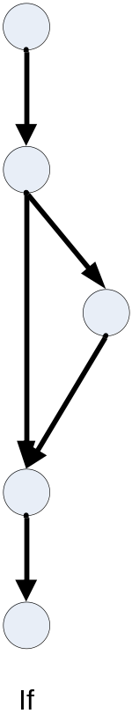
IF Diagram

Slide 84
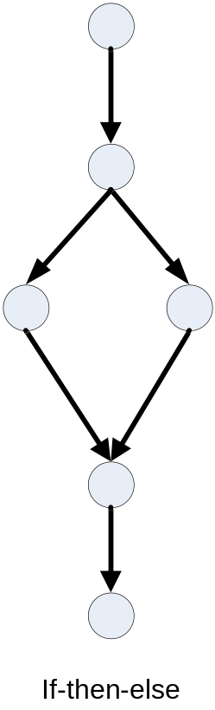
IF-THEN-ELSE Diagram

Slide 85
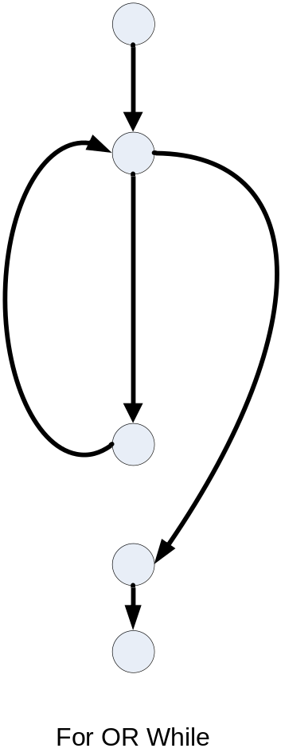
FOR or WHILE Diagram

Slide 86
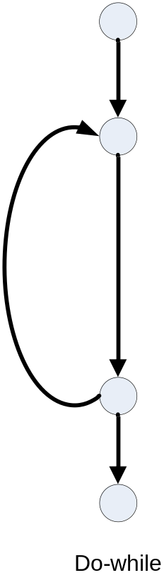
DO-WHILE Diagram

Slide 87
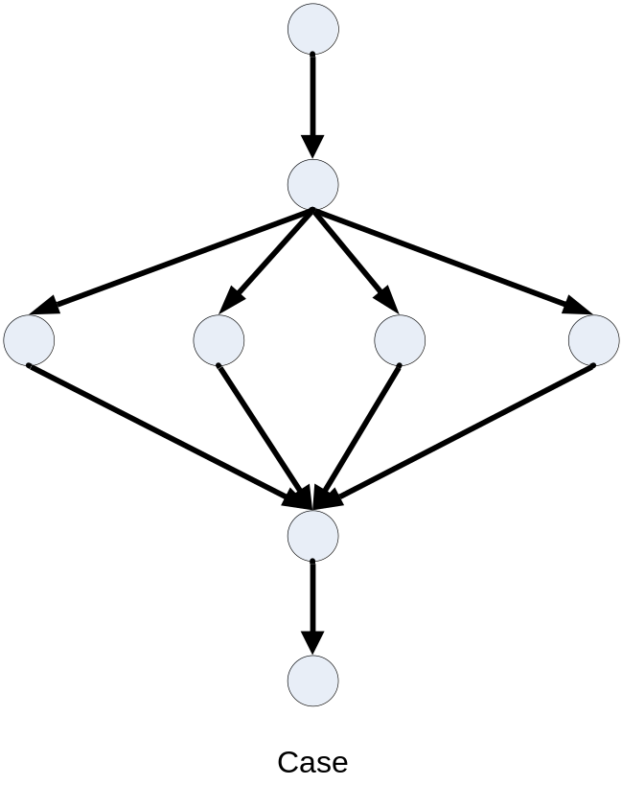
CASE Diagram

Slide 88
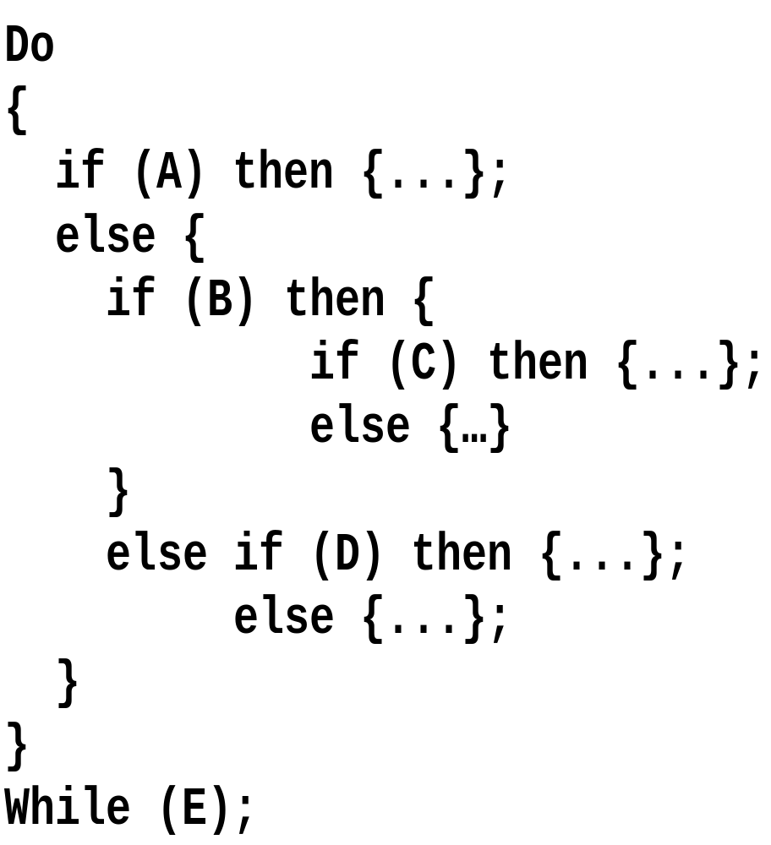
Example Code Fragment

Slide 89
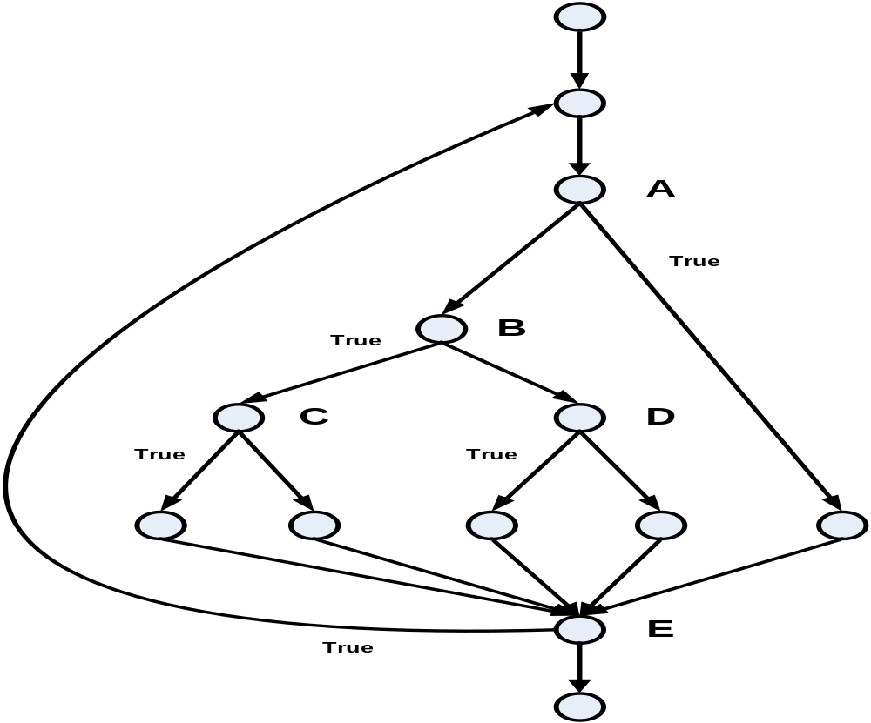
Example Control Flow Graph

Slide 90
Pseudo code and Control Flow Graphs
.
IF
a
IF
b
f
DO
k
c
g
i
WHILE
Node, statement
h
Edge, control flow
ENDIF
d
n
Name of edge
ENDIF
e

Slide 91
Statement Coverage
Statement Coverage requires that each statement will have been executed at least once.
Simplest form of logic coverage.
Also known as Node Coverage.
Also known as Co-coverage.
What is the minimum number of test cases required to achieve statement coverage for the program segment given below?

Slide 92
Minimum Requirement
Coverage of all the statements (nodes) of the control flow
  a,b,f,g,h,d,e

Slide 93
Statement coverage
Statement coverage
is normally measured
by a software tool.
percentage of executable statements exercised by a test suite
  number of statements exercised
  total number of statements
example:
  program has 100 statements
  tests exercise 87 statements
  statement coverage = 87%
=
?
Typical ad hoc testing achieves 60 - 75%

Slide 94
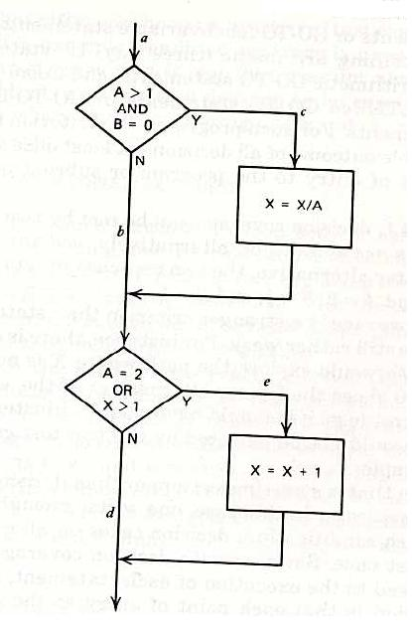
Example Code Fragment
If ((A>1) & (B=0)) then Do;
X=X/A;
END;
If ((A==2) | (X>1)) then Do;
X=X+1;
END;
END;

Slide 95
Statement Coverage
Exercise all statements at least once
How many test cases?
  A=2 and B=0 (ace)

Slide 96
Test Completion Criteria
Statement Coverage = (no. Of executed statements/ total no. Of statements)*100%

Slide 97
Advantages
Unreachable code can be detected
Empty else parts are not considered

Slide 98
Branch Coverage
Branch Coverage requires that each branch will have been traversed, and that every program entry point will have been taken, at least once.
Also known as Edge/Decision Coverage.
Execution of decision is considered
Empty ELSE parts are taken into considerations

Slide 99
Test Cases
Additional Test Cases are necessary
  a,b,f,g,h,d,e
  a,b,c,d,e
  a,b,f,g,i,g,h,d,e
  a,k,e

Slide 100
Example 1
Wait
Wait for card to be inserted
IF card is a valid card THEN
display “Enter PIN number”
IF PIN is valid THEN
select transaction
ELSE (otherwise)
display “PIN invalid”
ELSE (otherwise)
reject card
End
Valid
card?
Yes
Display
“Enter..
No
Reject
card
Valid
PIN?
Yes
Select
trans...
No
Display
“PIN in..
End

Slide 101
Example 2
Read
Read A
IF A > 0 THEN
IF A = 21 THEN
Print “Key”
ENDIF
ENDIF
IF A = 21 THEN
ENDIF
Print “Key”
IF A > 0 THEN
ENDIF
Read A
A>0
Yes
A=21
Yes
No
No
Print
End
  Minimum tests to achieve:
    Statement coverage: _____1_
    Branch coverage: ____3_

Slide 102
Example 3
Read
Read A
Read B
IF A > 0 THEN
IF B = 0 THEN
Print “No values”
ELSE
Print B
IF A > 21 THEN
Print A
ENDIF
ENDIF
ENDIF
A>0
B=0
No
Yes
Print
No
Yes
A>21
Yes
Print
Print
No
End
  Minimum tests to achieve:
    Statement coverage: ______
    Branch coverage: _____
2
4

Slide 103
Branch/Condition Testing
Branch condition testing is that each atomic condition in the test shall adopt the values TRUE or FALSE
Branch/Condition Coverage requires that both Branch AND Condition Coverage will have been achieved.
Therefore, Branch/Condition Coverage subsumes both Branch Coverage and Condition Coverage.
Weaker criteria than Branch or Statement coverage

Slide 104
Branch/Condition Testing
All combination of the logical values i,e TRUE –FALSE combination
It is also called multiple condition coverage
Branch condition combination testing includes statement and branch coverage.
Compound Condition Coverage requires that all combinations of condition values at every branch statement will have been covered, and that every entry point will have been taken, at least once.

Slide 105
Example
Each decision has a true and a false outcome at least once
How many test cases?
  A=2 and B=0 (ace)
  A=1 and X=1 (abd)

Slide 106
Advantages
More test cases than statement coverage
Detect the missing statement in the empty branches
100% B.C. =100% S.C.
But not vice versa
Branch coverage is stronger scriteria

Slide 107
Decision/Condition Coverage
Each condition in a decision takes on all possible outcomes at least once, and each decision takes on all possible outcomes at least once
How many test cases?
  A=2, B=0, and X=4 (ace)
  A=1, B=1, and X=1 (abd)
What about these?
  A=1, B=0, and X=3
  A=2, B=1, and X=1

Slide 108
Example
Four combination of test cases are possible with the test data for the two atomic parts of the condition (x>3, y<5)
X=6 (T),Y=3 (T), X>3 OR Y<5 (T)
X=6 (T),Y=8 (F), X>3 OR Y<5 (T)
X=2 (F), Y=3 (T), X>3 OR Y<5 (T)
X=2 (F), Y=8 (F), X>3 OR Y<5 (T)
Complete condition gives both Logical values as result

Slide 109
Branch Condition Combination Testing
Also called Multiple-Condition coverage
Exercise all possible combinations of condition outcomes in each decision
Conditions:
A>1, B=0
A>1, B<>0
A<=1, B=0
A<=1, B<>0
A=2, X>1
A=2, X<=1
A<>2, X>1
A<>2, X<=1

Slide 110
Multiple Condition Coverage
How many test cases?
  A=2, B=0, X=4
  A=2, B=1, X=1
  A=1, B=0, X=2
  A=1, B=1, X=1

Slide 111
Contd…
It includes Statement & Branch cverage
It is very expnsive
All combination can not always be implemented by test data

Slide 112
Condition Determination Testing
Eliminates the problems of Branch Condition combination testing
Restriction of combinations
Changing a partial condition without changing the result
Small no. of test cases
Used for complex cases
Expensive technique

Slide 113
Condition Coverage
Each condition in a decision takes on all possible outcomes at least once
Conditions: A>1, B=0, A=2, X>1
How many test cases?
  A=2, B=0, and X=4 (ace)
  A=1, B=1, and X=1 (abd)

Slide 114
Example
X=6 (T),Y=3 (T), X>3 OR Y<5 (T)
X=6 (T),Y=8 (F), X>3 OR Y<5 (T)
X=2 (F), Y=3 (T), X>3 OR Y<5 (T)
X=2 (F), Y=8 (F), X>3 OR Y<5 (T)

Slide 115
Path Coverage
Test object includes loop & conditions
Every possible number of repetitions is counted as one possible path through the program fragments
All possible paths through the test object
  A path describes the possible order of single program parts in a program fragment

Slide 116
Path Coverage
Every unique path through the program is executed at least once
How many test cases?
  A=2, B=0, X=4 (ace)
  A=2, B=1, X=1 (abe)
  A=3, B=0, X=1 (acd)
  A=1, B=1, X=1 (abd)

Slide 117
Advanced white box testing
A number of techniques use the data flow through the test object as the basis of identifying the test cases .

Slide 118
Instrumentation & Tool Support

Slide 119
Gray Box Testing
Gray box testing is a software testing technique that uses a combination of black box testing and white box testing.
Gray box testing is not black box testing, because the tester does know some of the internal workings of the software under test.
In gray box testing, the tester applies a limited number of test cases to the internal workings of the software under test. In the remaining part of the gray box testing, one takes a black box approach in applying inputs to the software under test and observing the outputs.

Slide 120
Difference between Black box & Gray box testing
In gray box testing, just as in black box testing, you test from the outside of a product, just as you do with black box, but you make better-informed testing choices because you're better informed; because you know how the underlying software components operate and interact.

Slide 121
Concepts
Gray box testing is a powerful idea.
The concept is simple; if one knows something about how the product works on the inside, one can test it better, even from the outside.
Gray box testing is not to be confused with white box testing; i.e. a testing approach that attempts to cover the internals of the product in detail.
Gray box testing is a test strategy based partly on internals. The testing approach is known as gray box testing, when one does have some knowledge, but not the full knowledge of the internals of the product one is testing.

Slide 122
ADVANTAGES OF GRAY BOX TESTING
Determine from the combination of advantages of Black Box Testing and White Box Testing.
DISADVANTAGES OF GRAY BOX TESTING
Determine from the combination of disadvantages of Black Box Testing and White Box Testing.

Slide 123
Intuitive & Experience Based Testing
Intuitive skills & experience of the tester
Exploratory Testing
Approach in “exploratory testing”
Test Character
Neither Black box nor White box
Not to be used as first or only technique

